Slide 1
Text Analytics 101
Rayid Ghani

Slide 2
What we’ll cove today
What kinds of analysis can be done with text data?
How do to those analysis?
What are they useful for?

Slide 3



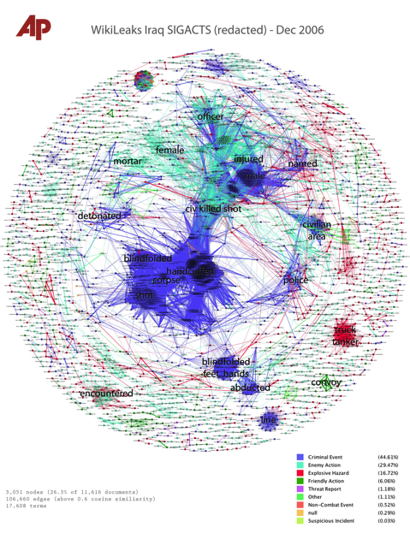
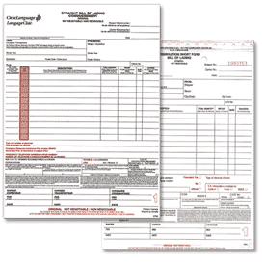

Where does text data come from?

Slide 4
Why is text data different?
Structured Data: Humans have already pre-determined the attributes and relations of interest (e.g. relational databases)
Text data can have too many possible dimensions (millions)
Text data often reflects human observations that are exceptions to regular processes.
Complaints, Suggestions, (the ubiquitous “other” field)

Slide 5
The ability to handle unstructured data enables new applications and improve existing ones.
Forms Processing
Email Response
Annotations Processing
Service Request processing
Supply Chain
Catalog Resolution / Schema Matching
CRM
Customer Interactions
Interactive Self-Service Websites
Skills Gap
Extracting Skills from Jos Postings, Resumes

Slide 6
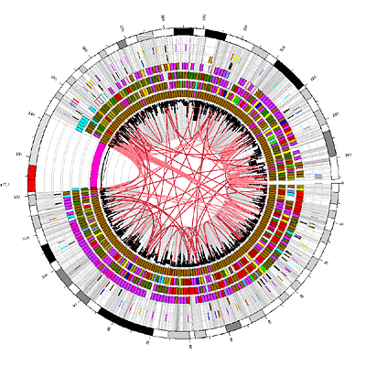
Text Analytics: Capabilities
Search
Classification
Clustering
Extraction
Summarization
Visualization

Slide 7
Text mining platforms require a variety of capabilities
Capability | Description | Maturity
Classification | Classification of a document into one or more previously defined content categories. (e.g. Classify incoming emails as personal, business, news article, etc.) | High
Word Clustering / Synonyms | Finding groups of words that are similar to each other. Depending on the strictness of the definition of similarity, similar words can be synonyms (IBM, Deep Blue) or companies in similar industry (Oracle, Teradata) | Low
Topic Detection / Clustering | Finding emerging or existing topics in large amounts of text data. Clustering news articles can help detect emerging topics. | High
Opinion & Sentiment Analysis | Detection of sentiment and opinions in different levels of granularity (word, sentence, message). | Medium
Named Entity Extraction (People, Locations, Organizations) | Recognition, tagging, and extraction of named entities of type Person, Location, and Organization. Typically limited to proper nouns and not much customization possible. | High
General Extraction (Entities, Events, Facts, Relationships) | Recognition, tagging, and extraction of specified classes of words /phrases as an entity (client, competitor, company), event (acquisition), relationship (John King works for MSFT) | Low
Search | Ranked retrieval of a document or component based on the presence of one or more supplied search terms. | High
Visualization | Visualization of text data and /or visual mashups combining text with other forms of data (maps, networks, etc). | Medium
Summarization | Summarization of a document, intended to produce a readable abstract of the source document which captures salient points using fewer words. | Low
7
Notes:
Add entity extraciont separate

Slide 8
Different Text analytics paradigms: Best is to use statistical machine learning augmented with lexicons and linguistics
 | Lexicon-based Rules | Linguistic Rules | Statistical Machine Learning (augmented with linguistics & lexicons)
Description | Rules based on lists of words | Rules using words and linguistic operators (parts of speech for example) | Statistical approaches that can be trained and learn over time. Can incorporate lexicons and linguistics as well
Ease of creation & maintenance | Low | Low | High
Accuracy | Low | Medium | High
Context Sensitiveness | Low | High | High
Interpretability | High (unless the rules get large) | Medium | Medium
Do it by hand
Hire linguists
Do it the right way

Slide 9
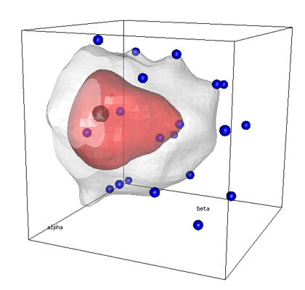

Statistical Machine Learning based approaches compensate for the shortcomings of rule-based systems
Model Training
Operational Use
Is this call about asthma?
Is this call about asthma?
Training Set
New Messages
✓
?
✗
Statistical Learning Algorithm
Machine Learning Model
✗
?
✓
✗
Model Trainer / Reviewer
Model Trainer
?
✓
✗
Lexicons
Update Model
Benefits of Machine Learning
Significantly cheaper approach to achieve a given level of accuracy compared to manual rule or lexicon creation
No advanced linguistic or technical skills to train and maintain the system (business users or analysts are the maintainers)

Slide 10
Text Analytics: Classification Pipeline
Input Data
Category 1
Document 1
Document 2
Category 2
Document 1
Document 2
Category …
Document
Document
Document …
Segmentation
Stop Word Removal
Stemming
Tokenization – Words
Background lexicons
Part of Speech Tagging
Phrase (n-gram) extraction
Feature Selection
Negation Handling
Feature Weighting
Feature Scaling
Pre-Processing
Classification Algorithms
Naïve Bayes
SVM
…
Classification Models

Slide 11
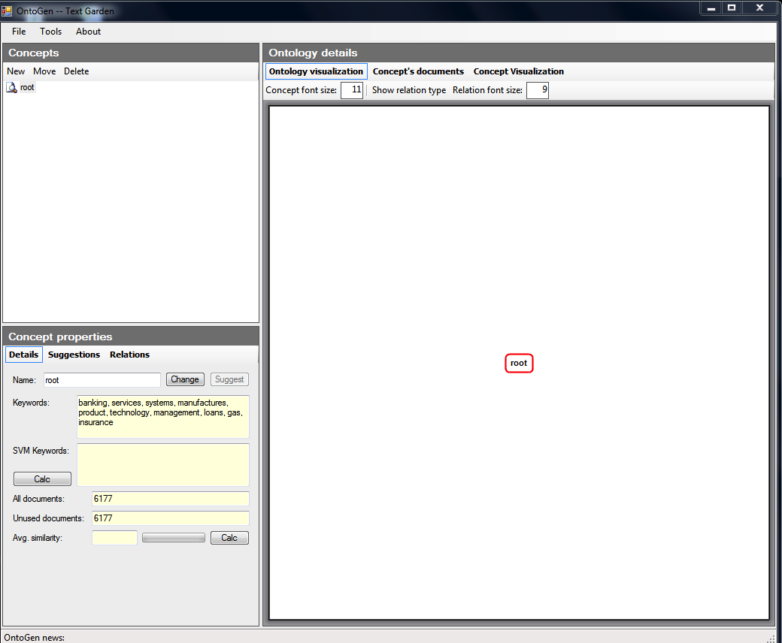
OntoGen: Interactively discovering topics and themes in large amounts of text data

Slide 12
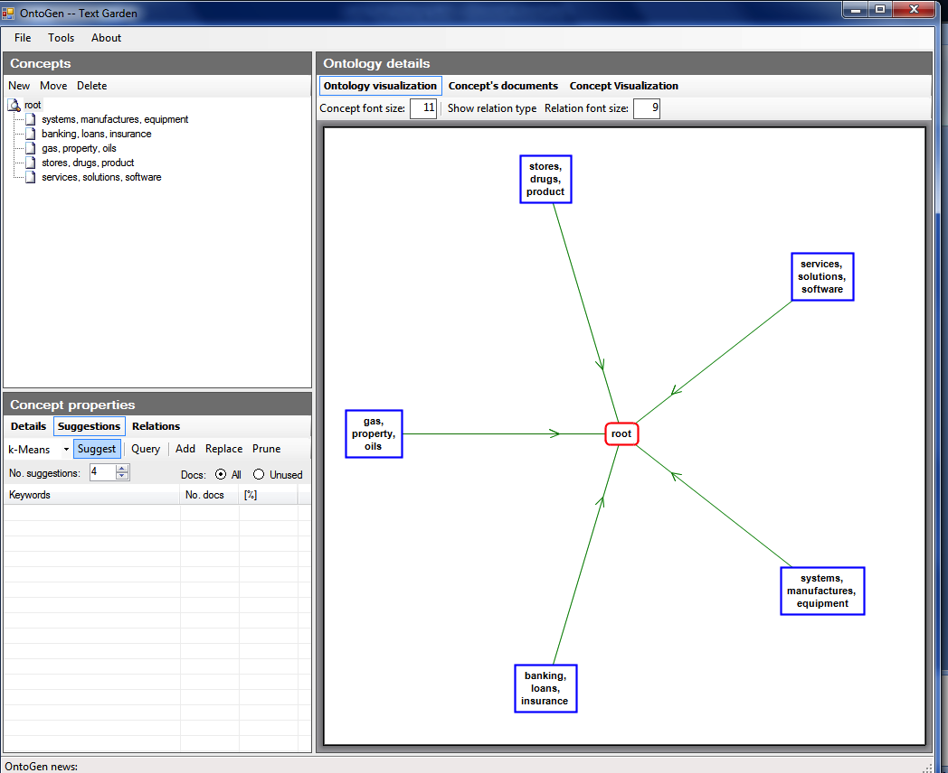
OntoGen: Interactively discovering topics and themes in large amounts of text data

Slide 13
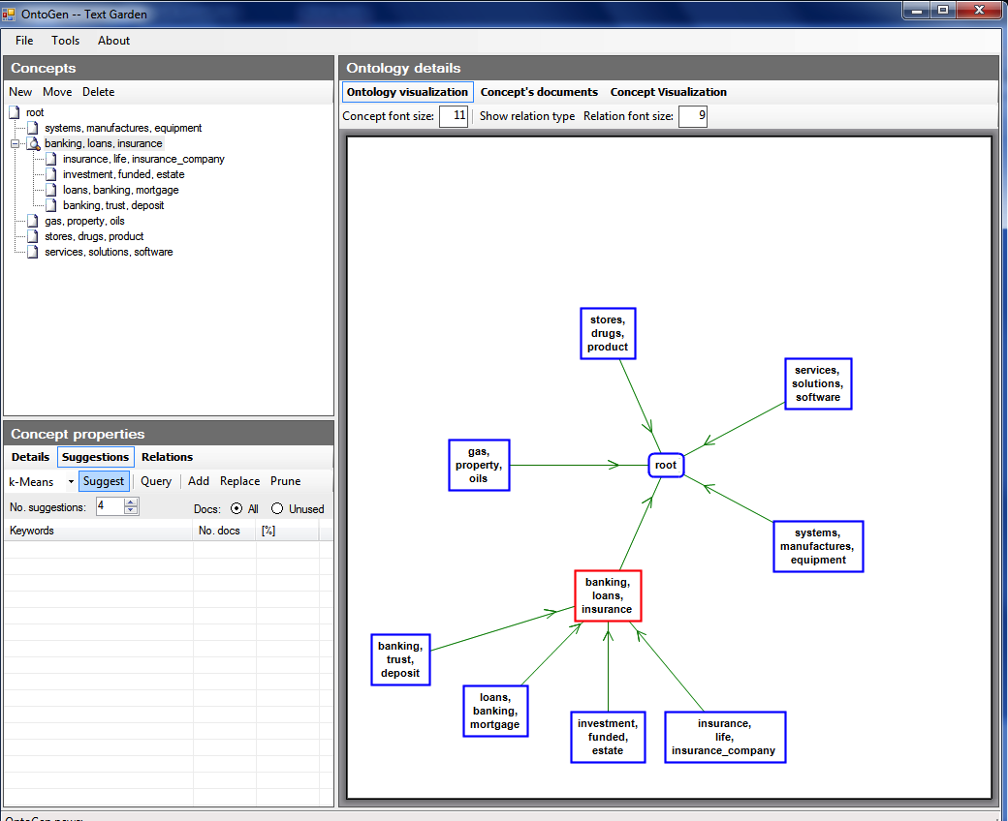

Slide 14
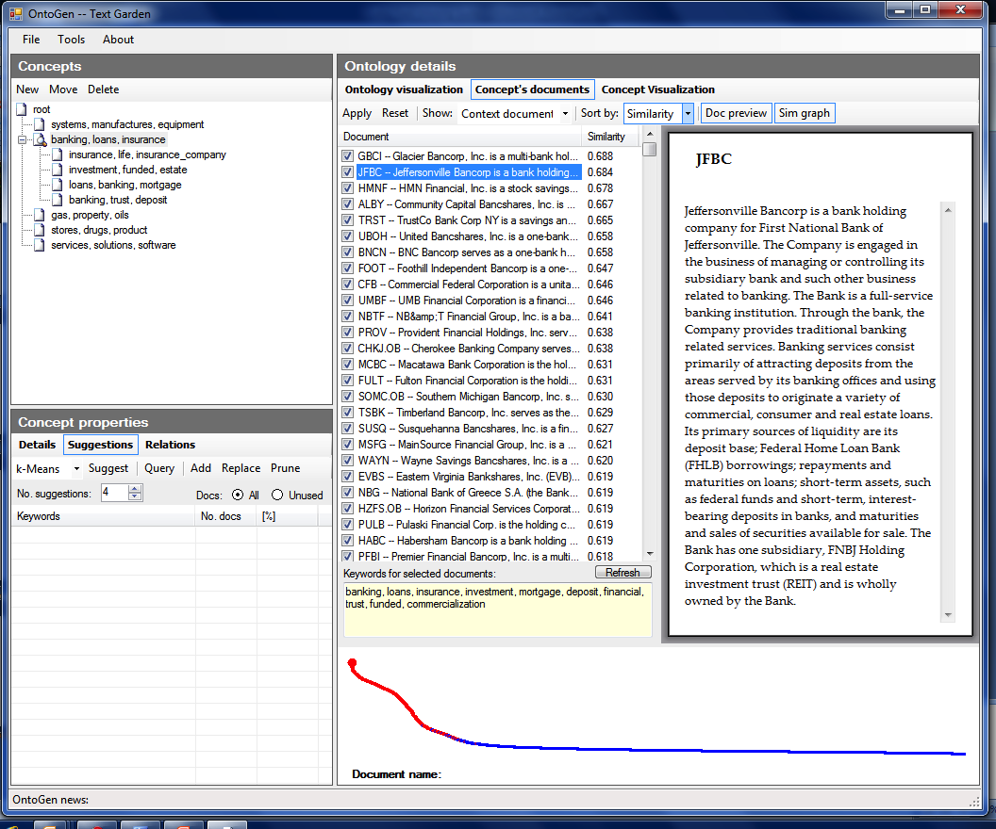

Slide 15
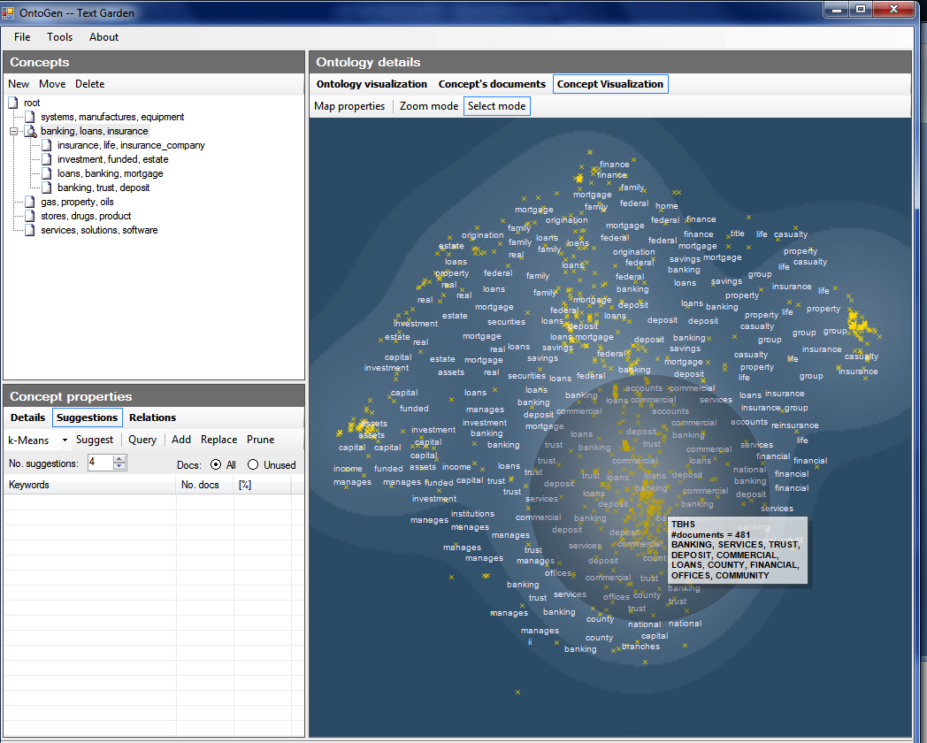

Slide 16
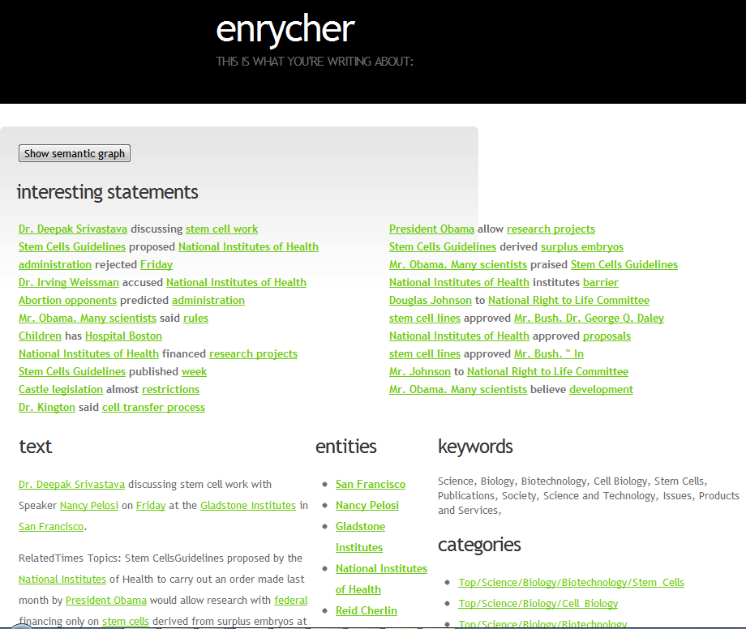

Slide 17
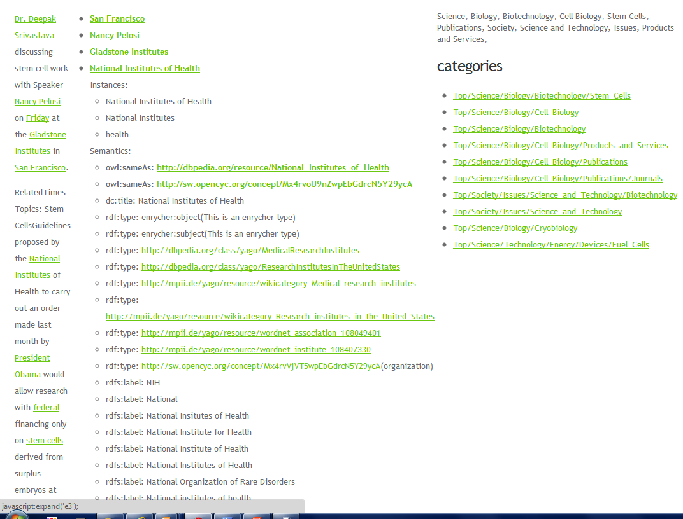

Slide 18
Examples
Classification: categorizing companies, patents, papers, etc.
Extraction: extracting names of people, organizations, technologies
Job-Resume Matching

Slide 19
Topic Models
“Soft” clustering for analyzing text corpora
Topic: probability distribution over words
Document: probability distribution over topics
Generative Model - To generate a document:
First select a topic
Then generate words from that topic’s distribution
Repeat
Latent Dirichlet Allocation (LDA) is the most common method

Slide 20
Topic Models
Python libraries
Gensim
Lda
pyLDAvis is a python libarary for interactive topic model visualization

Slide 21
Python Toolkit - NLTK
Book at http://www.nltk.org/
Useful scripts in nltk-trainer
You can also combine nltk and sklearn to do pre-processing in nltk and classification in sklearn
http://streamhacker.com/tag/classification/

Slide 22
Other NLP Components
Named Entity Recognition (NER)
Part of Speech Tagger
Parser

Slide 23
Online Resources
Interactive clustering tool Ontogen: ontogen.ijs.si
Tutorial at http://eprints.pascal-network.org/archive/00000017/01/Tutorial_Marko.pdf
Demos
http://cogcomp.cs.illinois.edu/page/demos/
https://dandelion.eu/semantic-text/text-classification-demo
List of commercial software http://www.kdnuggets.com/software/text.html

Slide 24
Contact Information
Rayid Ghani
rayid@uchicago.edu

